Slide 1
ABG Sundal collier life science summit
18 May, 2022
Jens lindberg, ceo

Slide 2
Important notice
You must read the following before continuing. The following applies to this document and the information provided in this presentation by Medivir AB (publ) (the “Company”) or any person on behalf of the Company and any other material distributed or statements made in connection with such presentation (the “Information”), and you are therefore advised to carefully read the statements below before reading, accessing or making any other use of the Information. In accessing the Information, you agree to be bound by the following terms and conditions.
The Information does not constitute or form part of, and should not be construed as, an offer of invitation to subscribe for, underwrite or otherwise acquire, any securities of the Company or a successor entity or any existing or future subsidiary or affiliate of the Company, nor should it or any part of it form the basis of, or be relied on in connection with, any contract to purchase or subscribe for any securities of the Company or any of such subsidiaries or affiliates nor shall it or any part of it form the basis of or be relied on in connection with any contract or commitment whatsoever. Specifically, this presentation does not constitute a “prospectus” within the meaning of the U.S. Securities Act of 1933, as amended.
The Information may not be reproduced, redistributed, published or passed on to any other person, directly or in directly, in whole or in part, for any purpose. The Information is not directed to, or intended for distribution to or use by, any person or entity that is a citizen or resident of, or located in, any locality, state, country or other jurisdiction where such distribution or use would be contrary to law or regulation or which would require any registration or licensing within such jurisdiction. The Information is not for publication, release or distribution in the United States, Australia, Canada or Japan, or any other jurisdiction in which the distribution or release would be unlawful.
All of the Information herein has been prepared by the Company solely for use in this presentation. The Information contained in this presentation has not been independently verified. No representation, warranty or undertaking, express or implied, is made as to, and no reliance should be placed on, the fairness, accuracy, completeness or correctness of the Information or the opinions contained herein. The Information contained in this presentation should be considered in the context of the circumstances prevailing at that time and will not be updated to reflect material developments which may occur after the date of the presentation. The Company may alter, modify or otherwise change in any manner the content of this presentation, without obligation to notify any person of such revision or changes.
This presentation may contain certain forward-looking statements and forecasts which relate to events and depend on circumstances that will occur in the future and which, by their nature, will have an impact on the Company’s operations, financial position and earnings. The terms “anticipates”, “assumes”, “believes”, “can”, “could”, “estimates”, “expects”, “forecasts”, “intends”, “may”, “might”, “plans”, “should”, “projects”, “will”, “would” or, in each case, their negative, or other variations or comparable terminology are used to identify forward-looking statements. There are a number of factors that could cause actual results and developments to differ materially from those expressed or implied in a forward-looking statement or affect the extent to which a particular projection is realized. Factors that could cause these differences include, but are not limited to, implementation of the Company’s strategy and its ability to further grow, risks associated with the development and/or approval of the Company’s products candidates, ongoing clinical trials and expected trial results, the ability to commercialize existing and any future products, technology changes and new products in the Company’s potential market and industry, the ability to develop new products, the impact of competition, changes in general economy and industry conditions and legislative, regulatory and political factors. While the Company always intends to express its best judgment when making statements about what it believes will occur in the future, and although the Company bases these statements on assumptions that it believe to be reasonable when made, these forward-looking statements are not a guarantee of its performance, and you should not place undue reliance on such statements. Forward-looking statements are subject to many risks, uncertainties and other variable circumstances. Many of these risks are outside of the Company’s control and could cause its actual results to differ materially from those it thought would occur. The forward-looking statements included in this presentation are made only as of the date hereof. The Company does not undertake, and specifically decline, any obligation to update any such statements or to publicly announce the results of any revisions to any of such statements to reflect future events or developments.

Slide 3

A unique, first-in-class, lead asset in liver cancer (HCC) & successful partnering strategy
Focused strategy with clear priority for first-in-class, orphan drug in liver cancer
Active partnering strategy for additional value creation across product portfolio

Slide 4








Strategic shift to oncology gathering momentum on the back of historically successful R&D team & in-house compounds
CD selection
for fostrox
USP-1 outlicense to Tango
Medivir founded as a spin-out from Astra AB
Birinapant & remetinostat deals
Olysio approved in Japan & US
Birinapant deal re-negotiated
1988
2013
2016
2020
2009
2014
2018
2021
Xerclear approved in US & EU – first Medivir product approval
Stratetgic shift to Oncology
Fostrox –
first-in-human
Fostrox phase 1b/2a combo initiated
CD selection
MIV-828
Birinapant outlicense to IGM
Remetinostat deal re-negotiated

Slide 5
Pipeline overview – in-house development & assets for partnering
Project | PARTNER | Disease area | Pre-clinical | Ph 1 | Ph 2 | Ph 3 | On market | Financials | Potential next event(S)
IN-HOUSE PROGRAM
Fostroxacitabine bralpamide | In-house development | HCC (mono) HCC (combo) |  |  |  |  |  | 100% Medivir | Selection of dose(s) Dose expansion
PARTNERING PROGRAMS
Xerclear | GSK, SYB | Herpes |  |  |  |  |  | Royalties | Registration in China
Remetinostat | TBD | CTCL, BCC, SCC |  |  |  |  |  | TBD | Partnering agreement
MIV-711 | TBD | Osteoarthirtis |  |  |  |  |  | TBD | Partnering agreement
Birinapant | IGM Biosciences | Solid tumors |  |  |  |  |  | Milestones (up to $350m) & royalties | Selection of dose Expansion cohort(s)
USP-1 | Tango Therapeutics | Cancer |  |  |  |  |  | Milestones & royalties | CD Selection US IND
USP-7 | Ubiquigent Limited | Cancer |  |  |  |  |  | Revenue share | Partnering agreement for Ubiquigent
Projects developed by Medivir
Projects developed by external partner

Slide 6
Fostrox – for the treatment of liver cancer

Slide 7

HCC is a significantly growing market with large unmet need
HCC market estimated to grow almost five-fold until 2029
Despite recent advancements, unmet need is still high
Liver cancer incidence and mortality are increasing with liver cancer the third leading course of cancer death worldwide 3%^{1,2}
Despite recent advances in treatment of HCC, still only ~1/3 of patients respond to the best approved combination therapies
The HCC market growth is driven by combination therapies and patients treated in earlier disease stages
$5.3B
$1.1B
2020
2029
Source: GlobalData 2021

Slide 8

Fostrox – Innovative combination of proven technology & MoA to improve probability of success
Pro-drug tail
Active substance - troxacitabine
Enables oral administration
Ensures increased, liver targeted absorption, minimizing systemic exposure
Bypasses resistance mechanisms for increased efficacy
Chemotherapy that induces tumour selective DNA-damage & cell death, sparing normal liver tissue
Backbone therapy in most tumour types but so far not in liver cancer due to challenges, addressed by pro-drug solution

Slide 9

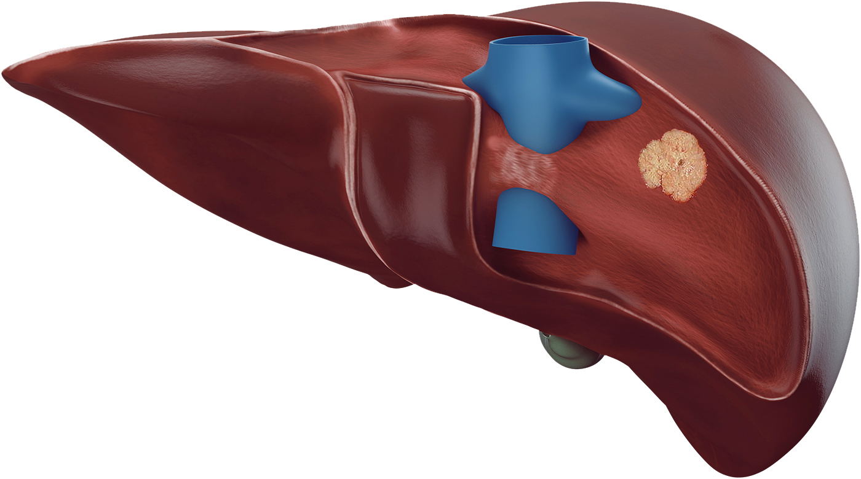




Fostrox – first-in-class, orphan drug inducing DNA damage & cell death selectively in liver tumor tissue
Differentiated mechanism of action (MoA) designed to be liver targeted & minimise systemic exposure
DNA-damage & cell death observed in tumor tissue but not in normal liver tissue*
Fostrox stable in intestine to reach liver
Cancer cells
TRX-TP
Rapid conversion in liver to active metabolite TRX-TP
Fostrox

Slide 10
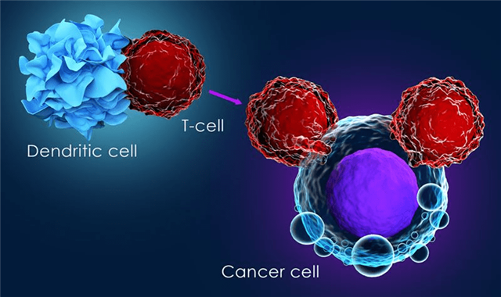
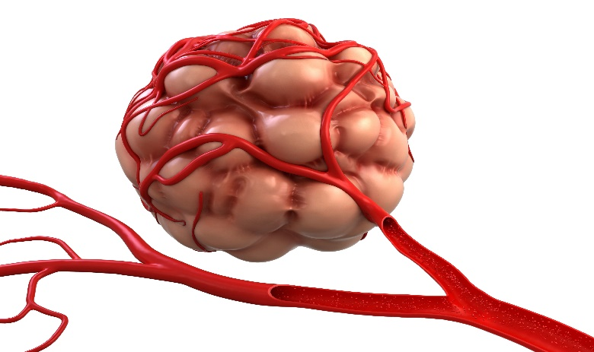

Current pipeline of new HCC therapies consists of a variation of combination trials with two key mechanisms of actions
Stimulation of immune system
Keytruda (PD-1)
Tezentriq (PD-L1)
Opdivo (PD-1)
Imfinzi (PD-L1)
Yervoy (CTLA-4)
Tremelimumab (CTLA-4)
Blocking blood supply to tumor*
Avastin
Nexavar
Lenvima
Stivarga
Cometriq/Cabometyx

Slide 11


Fostrox – A unique, differentiated MoA in HCC inhibiting DNA replication; strong potential for combinations
Fostrox + stimulation of immune system (PD-1)
Fostrox + blocking blood supply to tumor (TKI)
Fostrox – Rapid conversion in liver to active metabolite
Fostrox – Rapid conversion in liver to active metabolite
“Fostrox induces DNA damage and tumor cell death, potentially leading to increased tumor antigen presentation and increased immune response”
“TKI´s induce lack of oxygen in tumors leading to increased PGK1* expression and most importantly higher levels of fostrox active metabolite”

Slide 12
Fostrox – next step; phase 1b/2a combination study

Slide 13

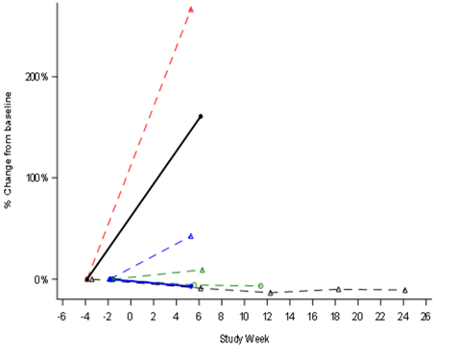
Phase 1b monotherapy results presented at ESMO supports continued development of fostroxacitabine bralpamide
Encouraging changes in liver target lesions*
Safety profile supports moving forward with development
LM
Decreases in blood cell counts were the most common side effects, these resolved quickly
In phase 1b four patients out of seven with primary liver cancer (e.g. HCC, iCCA) had stable disease as best overall response; one stayed on treatment for eight months
Liver biopsy data has demonstrated delivery of
fostrox to the liver, and a selective effect of fostrox on cancer cells vs normal liver tissue, across different types of cancer
LM = Liver Metastatic Disease
iCCA = Intrahepatic Bile Duct Cancer
HCC = HepatoCellular Carcinoma
LM
iCCA
HCC
HCC
HCC
LM
HCC

Slide 14








Fostrox – continued momentum moving into 22/23
Selection of combo dose & decision to move into dose expansion
Orphan drug status in US & EU
CD selection
2016
2020
2022
‘
2018
2021
2023
Monotherapy
first-in-human
Phase 1b mono data presented at ESMO
Phase 2a combo data – efficacy & safety
Combo with PD-1/TKI
first-in-human
US IND

Slide 15
Ongoing phase 1b/2a combination study in 2nd line HCC exploring combinations with both anti-PD-1 & TKI
Dose escalation – phase 1b
Dose expansion – phase 2a
Study Details & Objectives
Patient Population:
  2L advanced inoperable HCC, Child-Pugh A
  progressed on or intolerant of 1L SOC therapy for HCC, including atezo/bev patients
  Primary Objective:
  assess safety and tolerability as combination therapy
  determine recommended phase 2 doses
  Secondary Objective:
  to evaluate tumor response rate based on RECIST v1.1
Decision point
Finalise phase 2 dose for each combination
Which combination(s) to take into phase 2, one or both
Fostrox + Lenvima®
10-40 mg, dose cohorts of 3 patients
Fostrox + Lenvima®
Recommended Ph 2 dose , n=15/30*
Fostrox + Keytruda®
10-40 mg, dose cohorts of 3 patients
Fostrox + Keytruda®
Recommended Ph 2 dose , n=15/30*
Investigator sites split 60/40 EU & Asia

Slide 16
Strategic evolution & vision for fostrox in liver cancer
Fostrox; Go-To option for combinations across liver related tumors
Beyond HCC
Explore potential in other liver related tumors beyond HCC such as CRC driven liver metastasis
BACKBONE IN HCC
Establish as backbone for combinations across HCC with potential for triple combinations & earlier lines
Early lines HCC
Launch as preferred combination partner in select patient groups in early lines HCC with either TKI or PD-1
Notes:
Vision sets the long-term direction of the business
Speaks to the big question of what the brand / indication wants to achieve in the long run
The team needs to be aligned on the current market scenario for the near term strategic description and objectives. The desired market scenario or the market scenario your competition might drive you toward should be applied when describing the mid- and long-term strategic description and key objectives.
For reference, the 4 market scenarios are:
First One
New Treatment Paradigm
Superior Profile to Standard of Care
Limited Differentiation
Note: Goals should be written SMART (Specific, Measurable, Achievable, Relevant, and Time-Bound) and as a future outcome.

Slide 17
Pipeline overview – in-house development & assets for partnering
Project | PARTNER | Disease area | Pre-clinical | Ph 1 | Ph 2 | Ph 3 | On market | Financials | Potential next event(S)
IN-HOUSE PROGRAM
Fostroxacitabine bralpamide | In-house development | HCC (mono) HCC (combo) |  |  |  |  |  | 100% Medivir | Selection of dose(s) Dose expansion
PARTNERING PROGRAMS
Xerclear | GSK, SYB | Herpes |  |  |  |  |  | Royalties | Registration in China
Remetinostat | TBD | CTCL, BCC, SCC |  |  |  |  |  | TBD | Partnering agreement
MIV-711 | TBD | Osteoarthirtis |  |  |  |  |  | TBD | Partnering agreement
Birinapant | IGM Biosciences | Solid tumors |  |  |  |  |  | Milestones (up to $350m) & royalties | Selection of dose Expansion cohort(s)
USP-1 | Tango Therapeutics | Cancer |  |  |  |  |  | Milestones & royalties | CD Selection US IND
USP-7 | Ubiquigent Limited | Cancer |  |  |  |  |  | Revenue share | Partnering agreement for Ubiquigent
Projects developed by Medivir
Projects developed by external partner

Slide 18
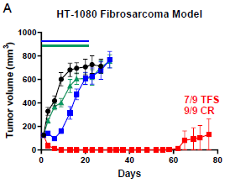
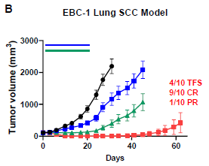
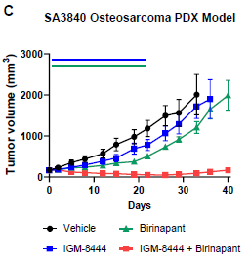
Birinapant – Licensing agreement with IGM Biosciences
Continued clinical momentum in 2022
Strong synergistic cytotoxicity
across multiple solid tumor indications²
Birinapant + IGM-8444, a DR5 agonist, now in phase 1 in patients with solid tumors¹
The first dose escalation cohort cleared with no DLTs to date, currently enrolling second cohort.
Potential development, regulatory and sales milestone payments up to a total of approximately USD 350 million plus tiered royalties from the mid-single digits up to mid-teens on net sales

Slide 19
Fostrox – A unique, first-in-class potential treatment for primary liver cancer
Significant unmet need & commercial potential; fostrox complementing, not replacing, existing therapies
Unique MoA that selectively targets cancer in the liver and bypasses resistance mechanisms
Induction of DNA-damage & cell death well established in cancer, strong potential for attractive combinations

Slide 20
Q&A

